Slide 1
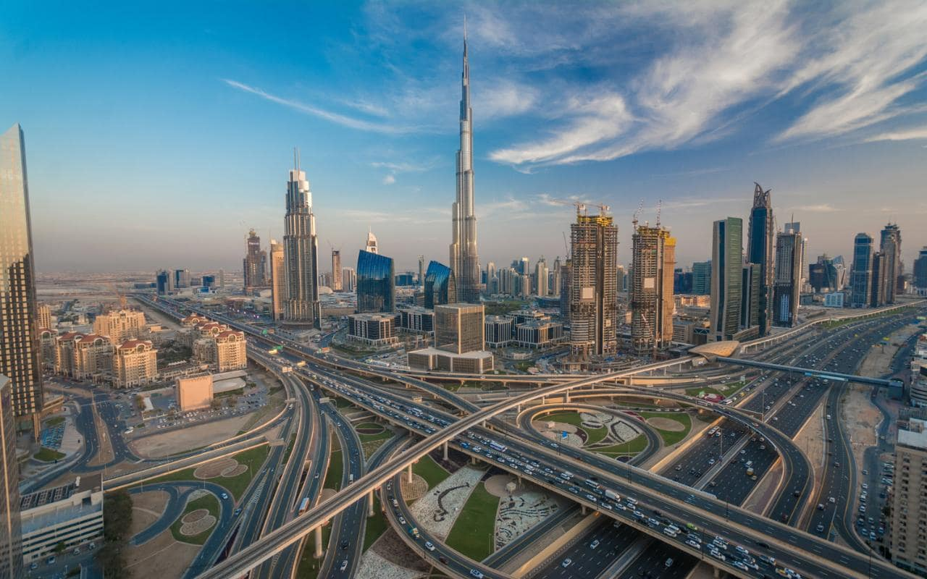
DUBAI – A MODERN CITY

Slide 2
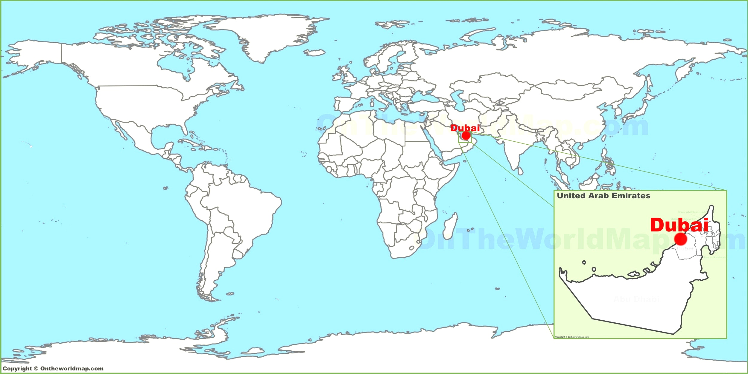
A FACTFILE
Dubai is one of several emirates in the UAE
Boasts some of the biggest and expensive buildings in the world i.e.
Burj Khalifa - $1.5b
Burj Al Arab - $1b
Spire - E4m
Population - ~3 million
20% Emirati
80% Expats
Profits
Not Just Oil & Petroleum!
IT – Internet City
Finance - DIFC

Slide 3
MODERN FEATURES
Revenue obtained from oil, trade, recently with finance, tourism and aviation.
GDP – $107.1 b
Oil worth 5% of total revenue. 50,00-70,000 barrels a day
Allocated Free Zones – Internet City, Media City, DMCC, Design District 2020
Booming - Real Estate, Gold Market, Shopping Malls
Transportation – Extremely Efficient Network and Hub
Education – Dubai International Academic City, Schooling very expensive
Healthcare – Mandatory Insurance, Medical Tourism

Slide 4
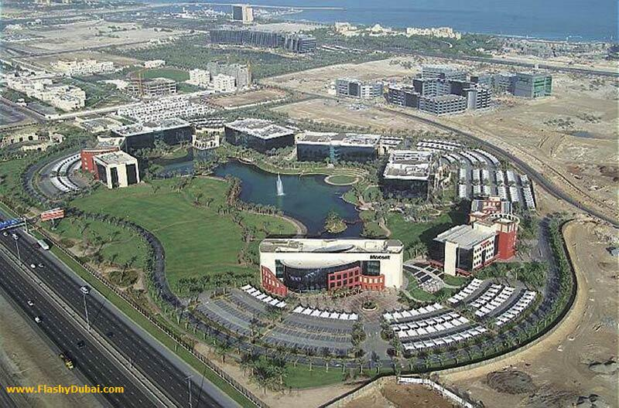
THE IT INDUSTRY
Localised around Internet City
Benefits include 100% ownership and taxation/customs benefits
Facebook, Google, Dell, Microsoft, IBM
1,400 companies in total
10,000 workers
https://www.cnbc.com/2015/12/21/3-reasons-dubai-is-rising-as-a-tech-start-up-hub.html
Location
Low Taxes -> Reward in itself
Free Trade policy

Slide 5
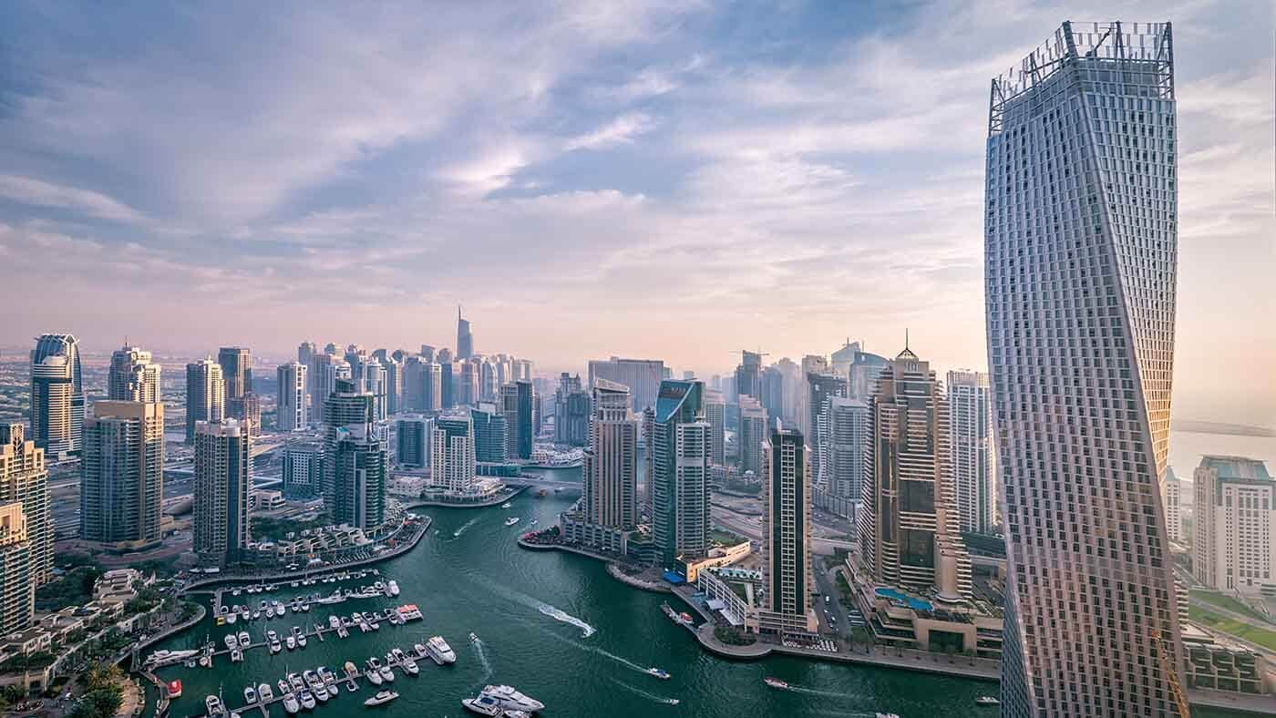
CONCLUSION
Still a long way to go!
Very Poor Human Rights
Hidden from view
Wealth Disparity – Ruling Class own 42%
No Social Insurance – Good or Bad?
Empty Buildings a bad sign?
Change will come as it becomes more developed
Booming IT, Finance, Petrochemicals Industries
Still growing and does not look like its going to stop anytime soon!!

Slide 6
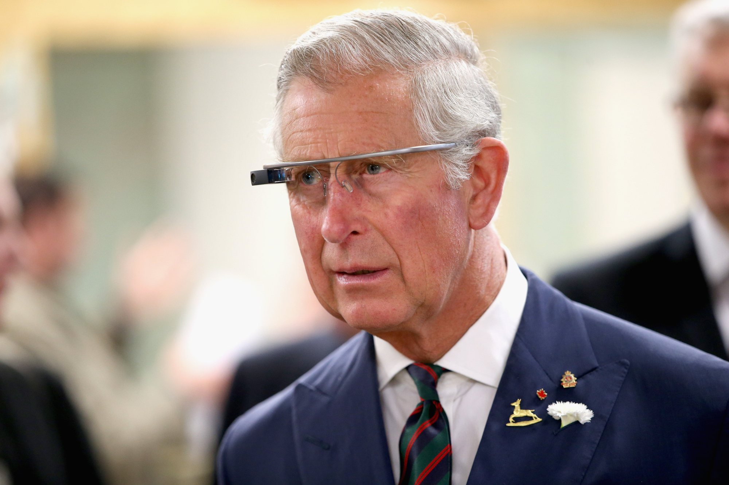
Any Questions?

